Slide 1
DIGITAL STREAM SYSTEM (DSS)
A medium for admins to manage the movie catalogue

Slide 2
AGENDA
What is
Digital Streaming System (DSS)
DSS Process Flow
DSS Code Walkthrough

Slide 3
Project abstract
Digital Stream System is a digital streaming application that allows administrators to manage the movie catalog with relevant information about the movies, actors, and movie reviews (like Netflix or Amazon Prime, IMBD).
This application allows the administration to store and manage details of movies, actors, and movie reviews.

Slide 4
Project goals
To design and develop a Monolithic and Microservice application of a Digital Streaming System.
To use development tools and technologies like Java 11, Spring boot, Spring Data JPA, and PostgreSQL in building Digital Streaming System app.
To create REST API for a Digital Streaming System.
To create an account and log in to Digital Streaming System.
To add, view, update and delete movies.
To add, view, update and delete actors.
To search movies and display the details.
To test REST APIs with Swagger and Postman.

Slide 5
DSS PROCESS FLOW

Slide 6
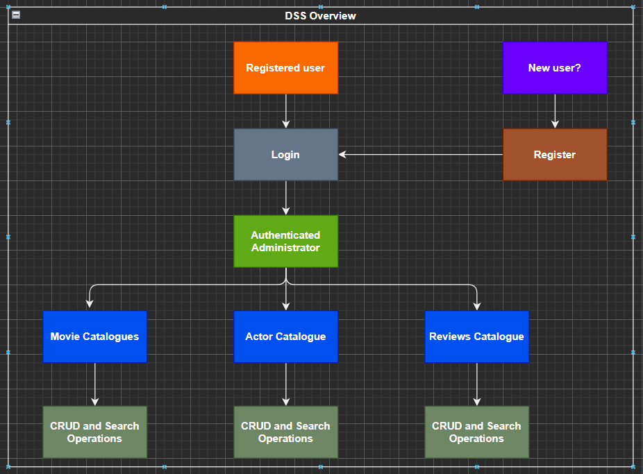
DSS Process Flow

Slide 7
DESIGN AND UNDERSTANDING REQUIREMMENTS

Slide 8
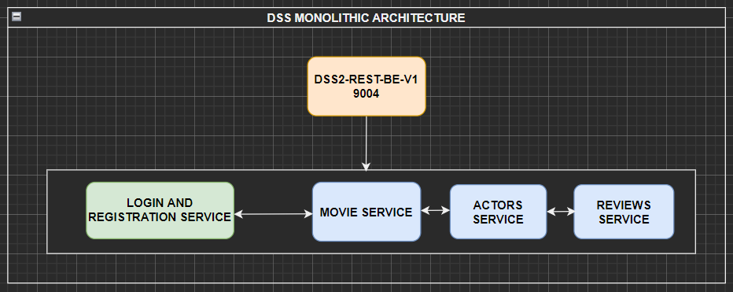
Architecture : high level monolithic

Slide 9
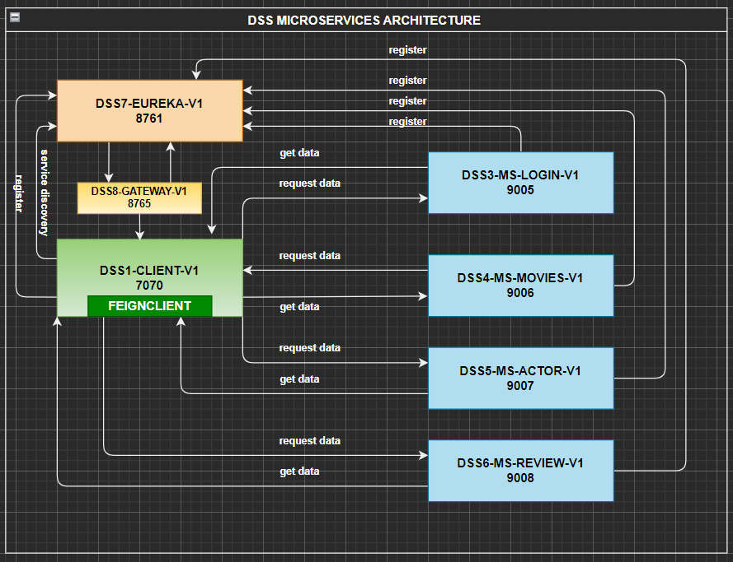
Architecture : high level microservices

Slide 10
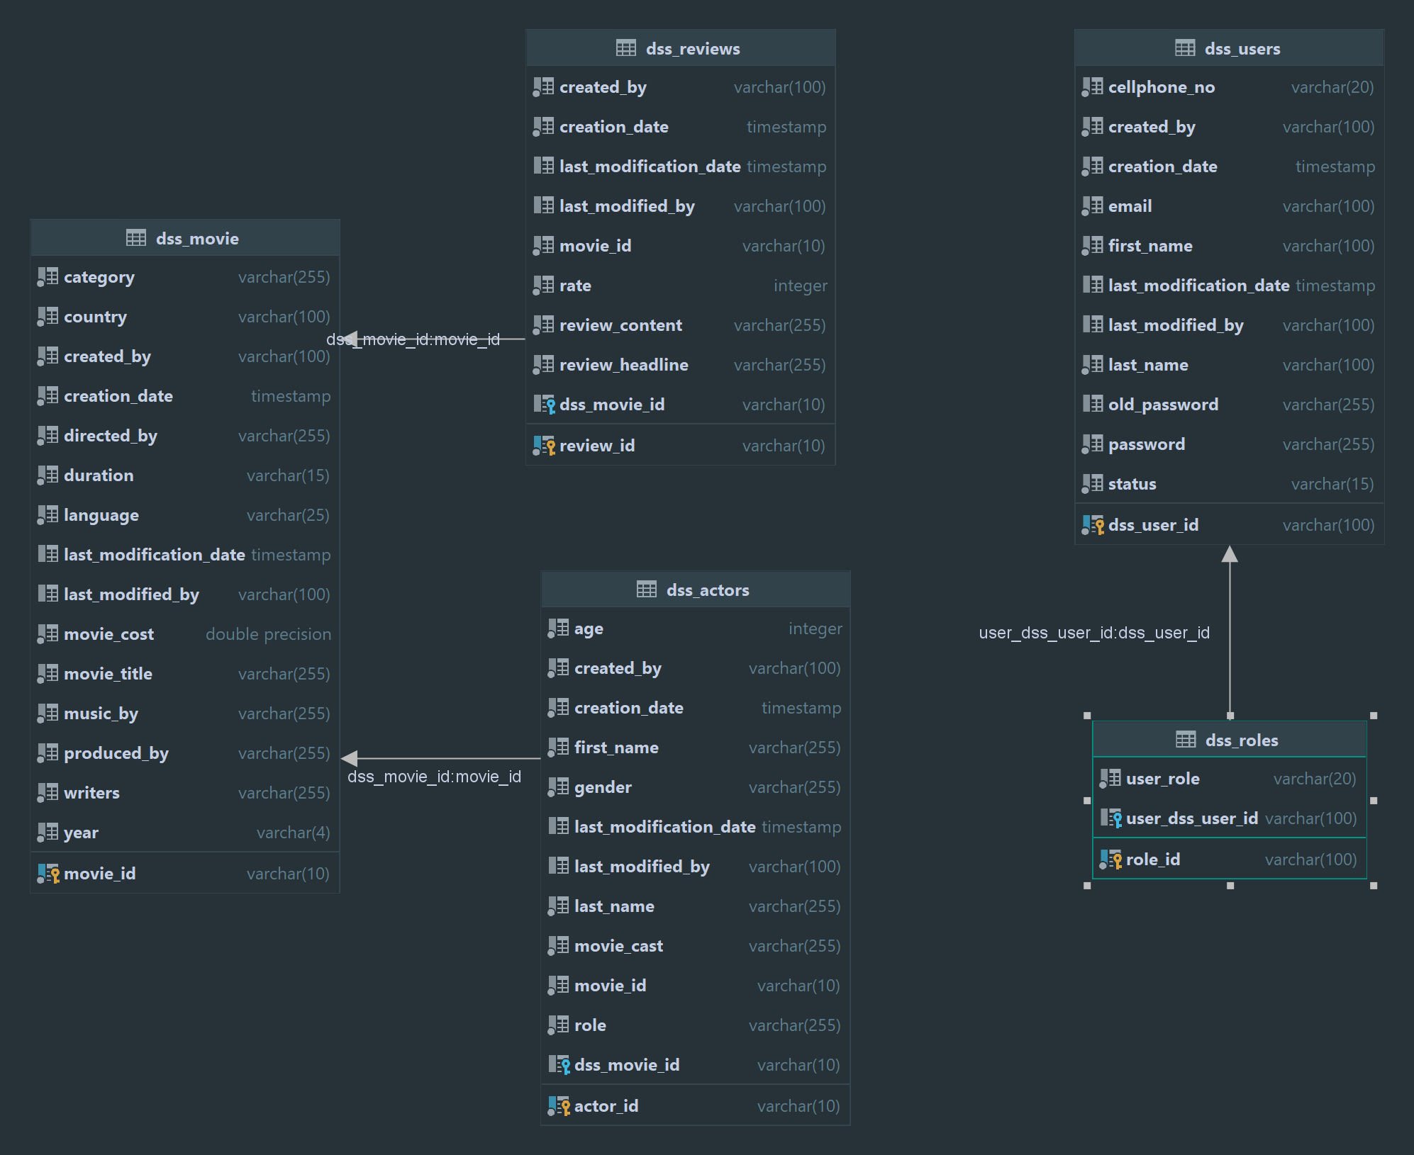
ENTITY RELATIONSHIP DIAGRAM

Slide 11
Layered architecture
UI Layer
Controller layer
Service layer
Repository layer

Slide 12
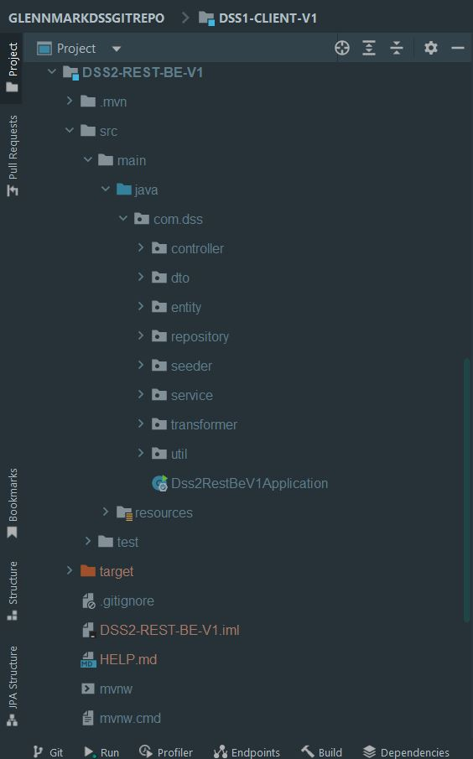
Layered architecture implemented with maven
Three Different Repositories
File Repository
Repository with Collections
Repository connected to PostgreSQL

Slide 13
Unit testing
Testing (Junit)
Code Coverage (Jacoco)

Slide 14
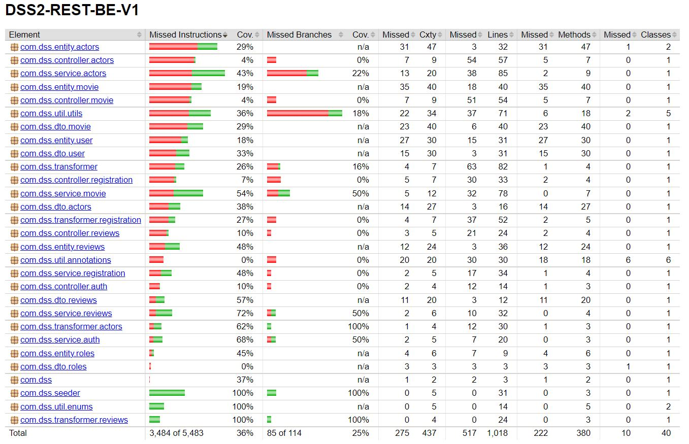
Testing with junit5

Slide 15
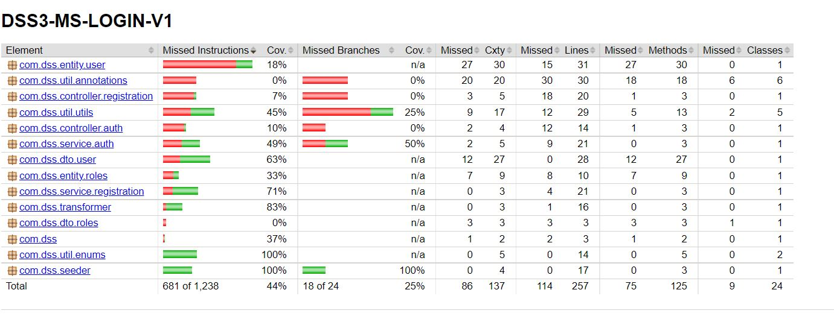
Testing with junit5 login and registration

Slide 16
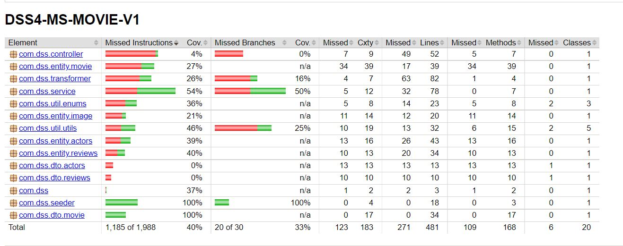
Testing with junit5 movies

Slide 17
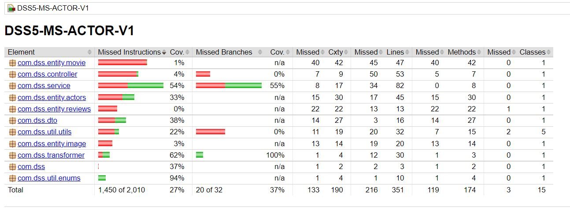
Testing with junit5 actors

Slide 18
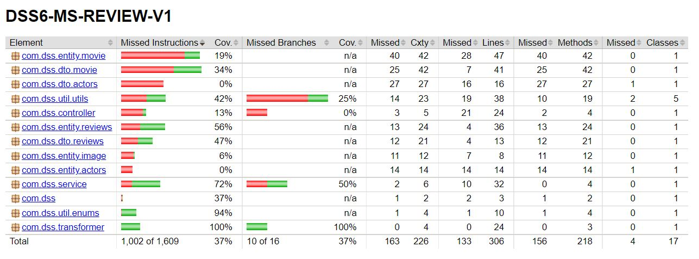
Testing with junit5 reviews

Slide 19
Testing rest api
Postman
Swagger

Slide 20
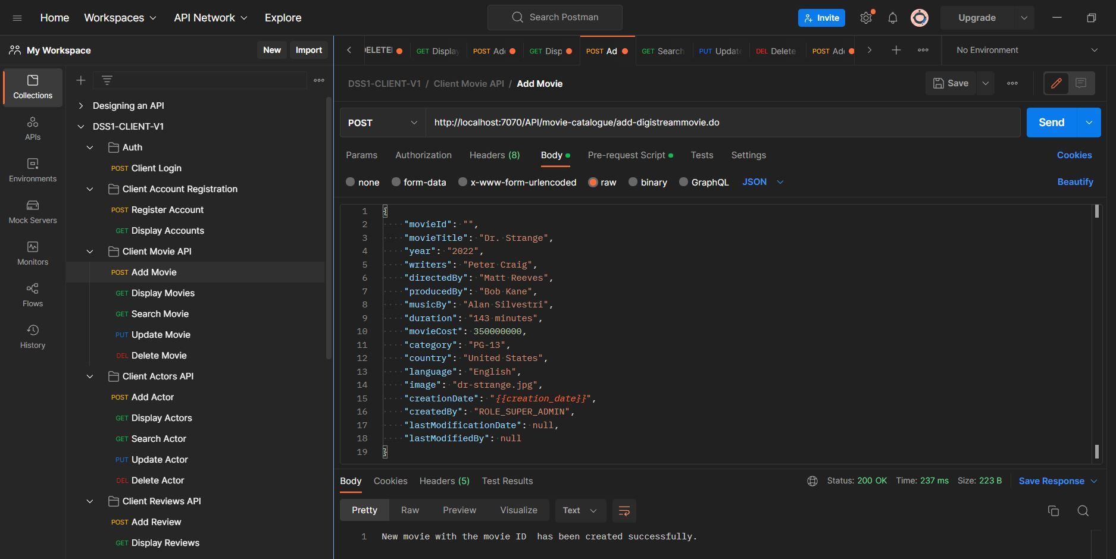
postman

Slide 21
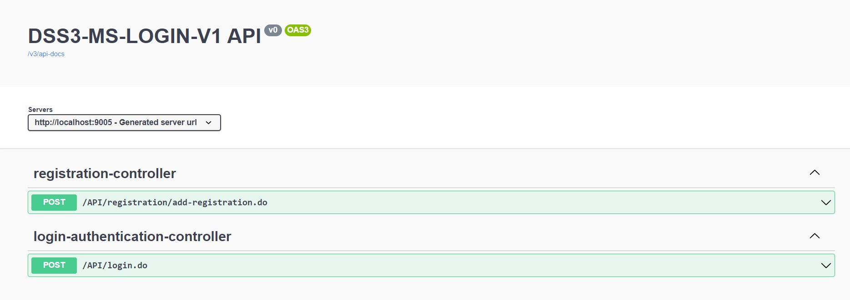
Swaggger login and registration services

Slide 22
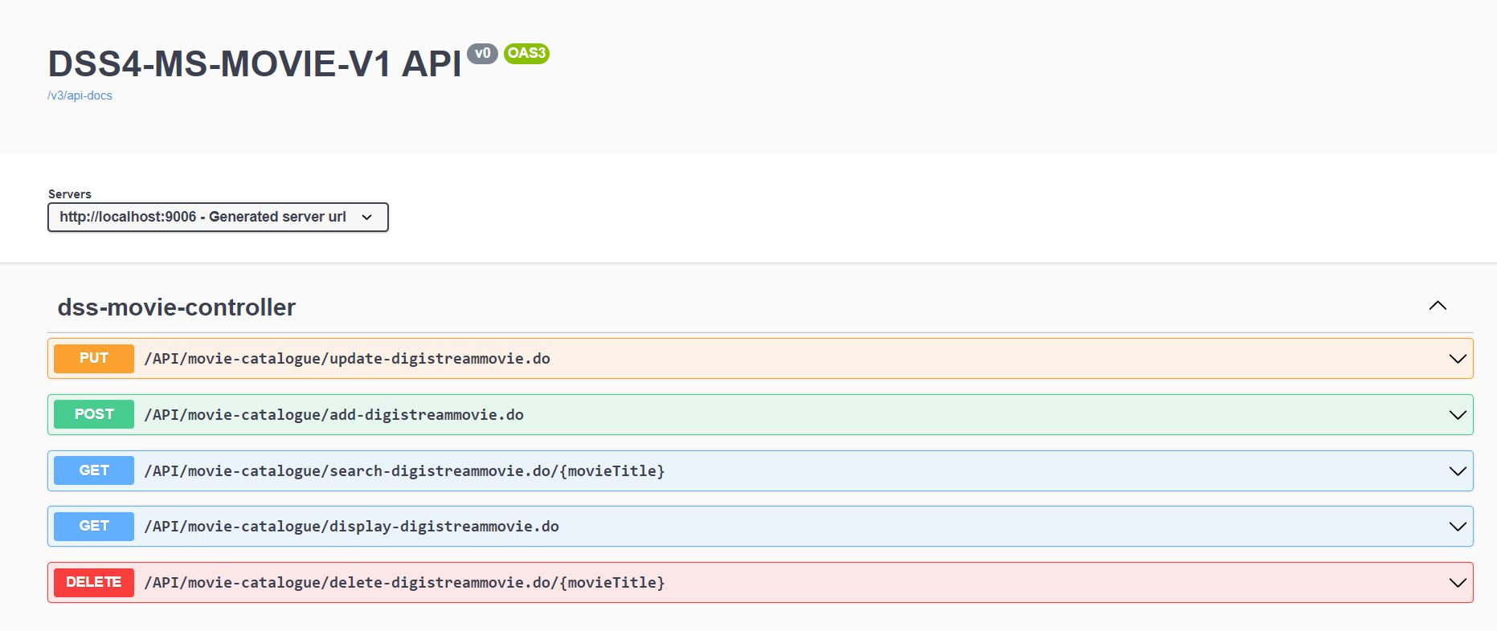
Swaggger movie services

Slide 23
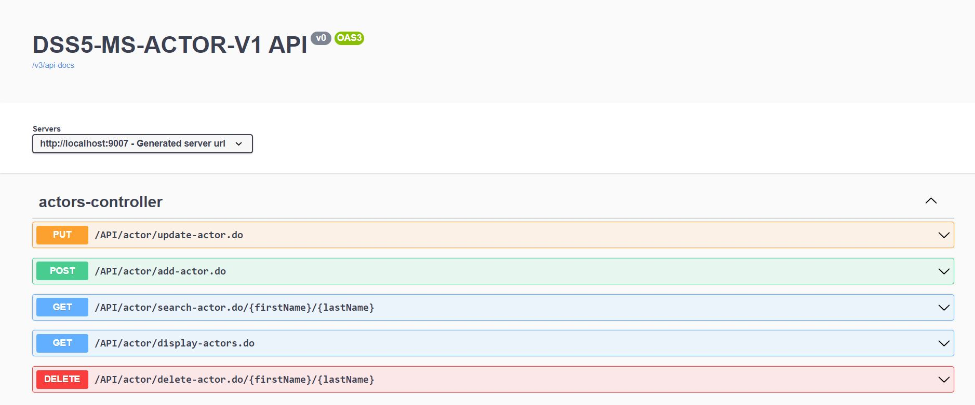
Swaggger actor services

Slide 24
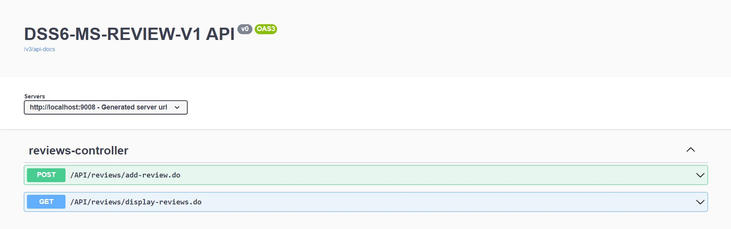
Swaggger review services

Slide 25
Git and github

Slide 26
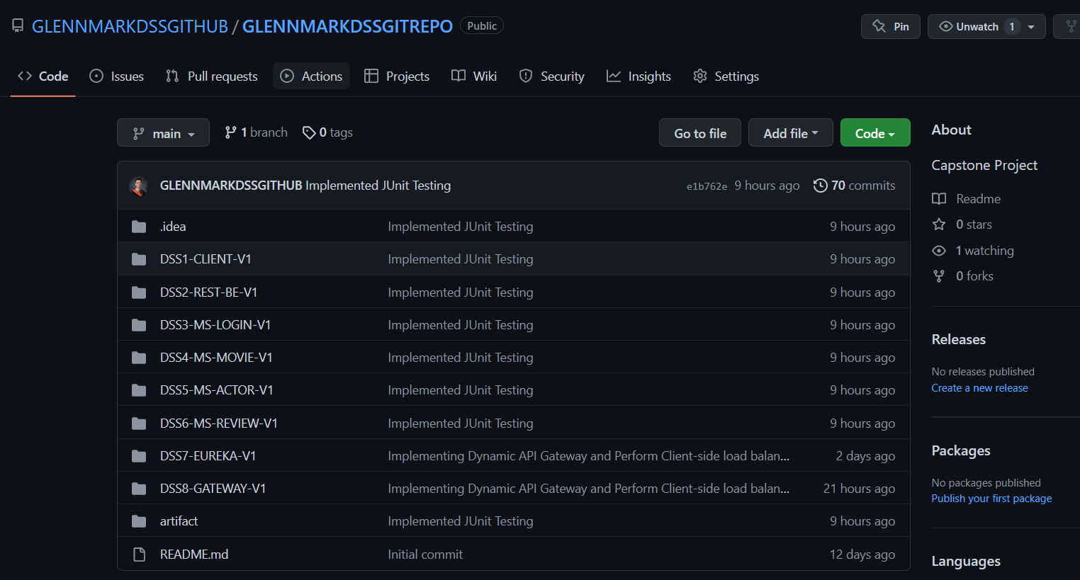
screenshots

Slide 27
Learning and experiences

Slide 28
Learning and experiences
Modular Developments
Microservices & Layered Architecture Implemented in Maven
Consume REST APIs in Spring boot
Testing an REST API using Postman and Swagger
Testing with JUnit5

Slide 29
Capstone backend

Slide 30




Development tools

Slide 31
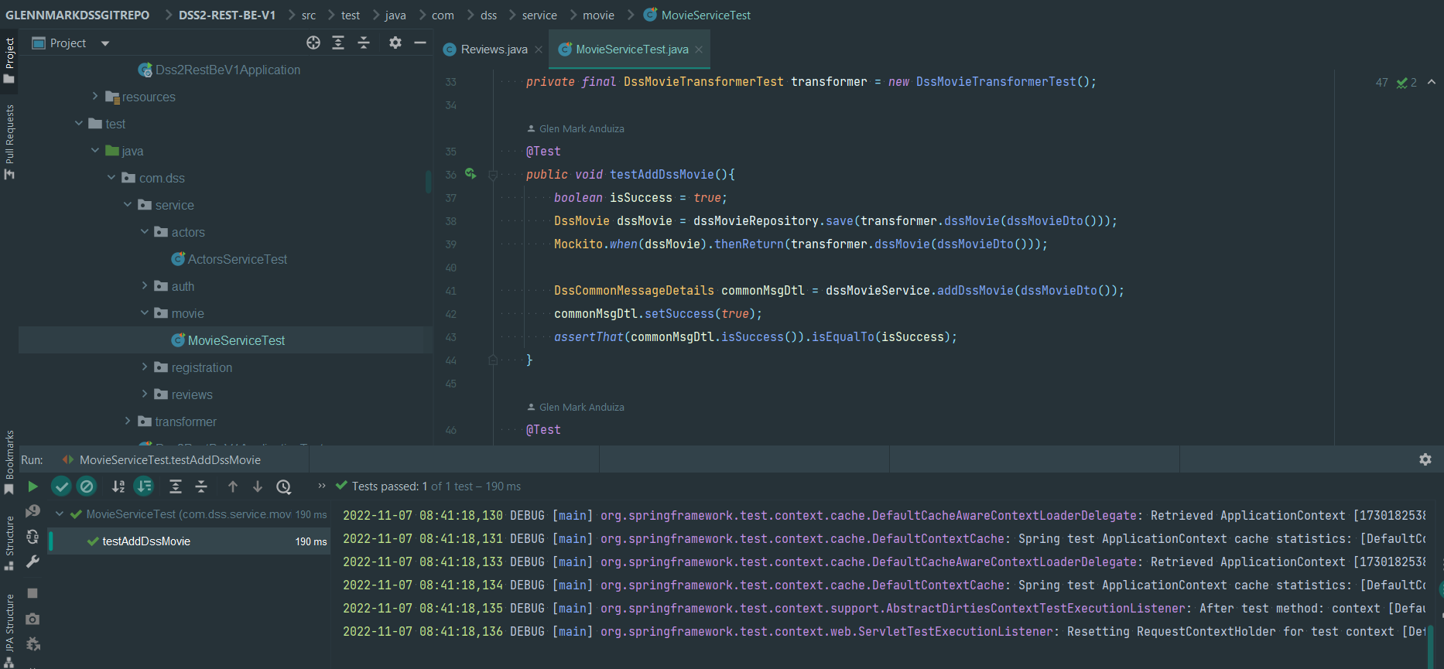
screenshots junit test case

Slide 32
Code snippets junit test case

Slide 33
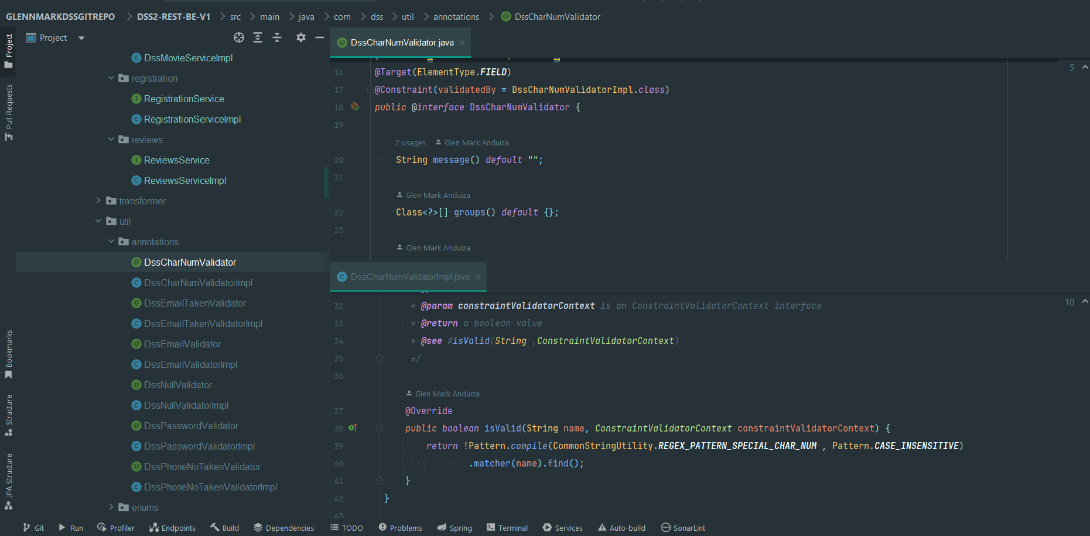
Code snippets user defined annotations

Slide 34
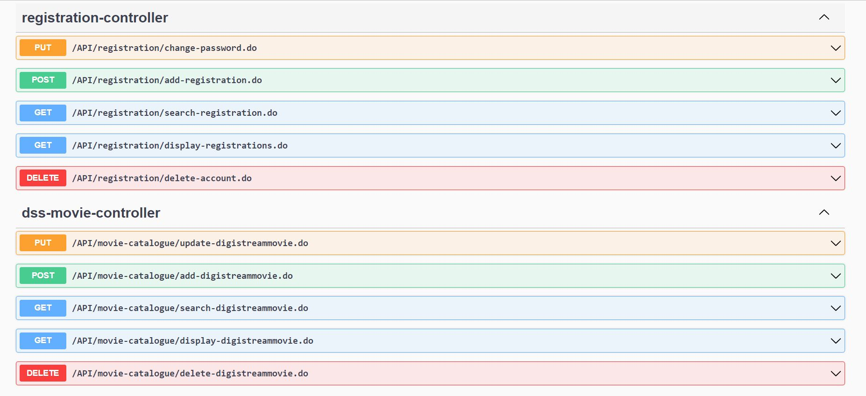
Code snippets swagger ui

Slide 35
Digital streaming system code walkthrough

Slide 36
controllers
LOGIN
/API/login.do
REGISTRATION
/API/registration/add-registration.do

Slide 37
controllers
MOVIES
/API/movie-catalogue/add-digistreammovie.do
/API/movie-catalogue/display-digistreammovie.do
/API/movie-catalogue/search-digistreammovie.do
/API/movie-catalogue/update-digistreammovie.do
/API/movie-catalogue/delete-digistreammovie.do

Slide 38
controllers
ACTORS
/API/actor/add-actor.do
/API/actor/display-actors.do
/API/actor/search-actor.do
/API/actor/update-actor.do
/API/actor/delete-actor.do
REVIEWS
/API/reviews/add-review.do
/API/reviews/display-reviews.do

Slide 39
SERVICE AND SERVICE IMPLEMENTATION
LOGIN
DssCommonMessageDetails login(String email, String password);
REGISTRATION
DssCommonMessageDetails registerAccount(UsersDTO user);
DssCommonMessageDetails displayRegistrations();

Slide 40
SERVICE AND SERVICE IMPLEMENTATION
MOVIES
DssCommonMessageDetails addDssMovie(DssMovieDTO dssDto);
DssCommonMessageDetails displayDssMovies();
DssCommonMessageDetails searchDssMovieByMovieTitle(String movieTitle);
DssCommonMessageDetails updateDssMovie(DssMovieDTO dssDto);
DssCommonMessageDetails deleteDssMovie(String movieTitle);

Slide 41
SERVICE AND SERVICE IMPLEMENTATION
ACTORS
DssCommonMessageDetails addActor(ActorsDTO actorDto);
DssCommonMessageDetails displayActors();
DssCommonMessageDetails searchActorByActorName(String firstName, String lastName);
DssCommonMessageDetails updateActor(ActorsDTO actorDto);
DssCommonMessageDetails deleteActor(String firstName, String lastName);
REVIEWS
DssCommonMessageDetails addReview(ReviewsDTO reviewsDto);
DssCommonMessageDetails displayReviews();

Slide 42
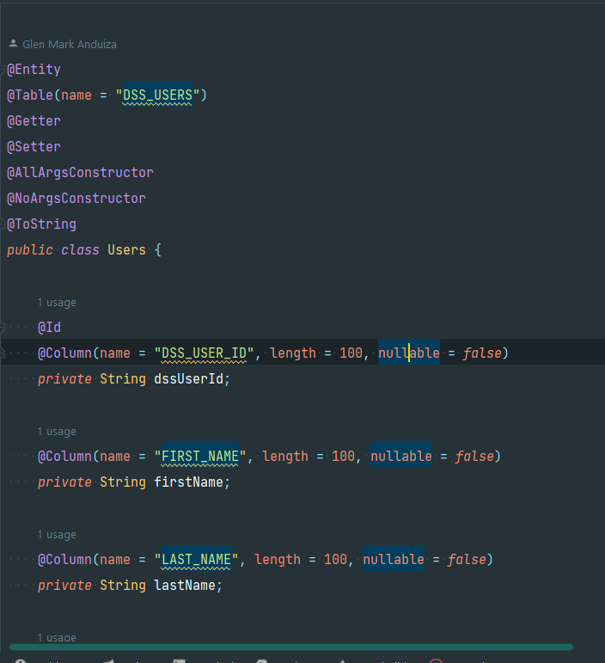
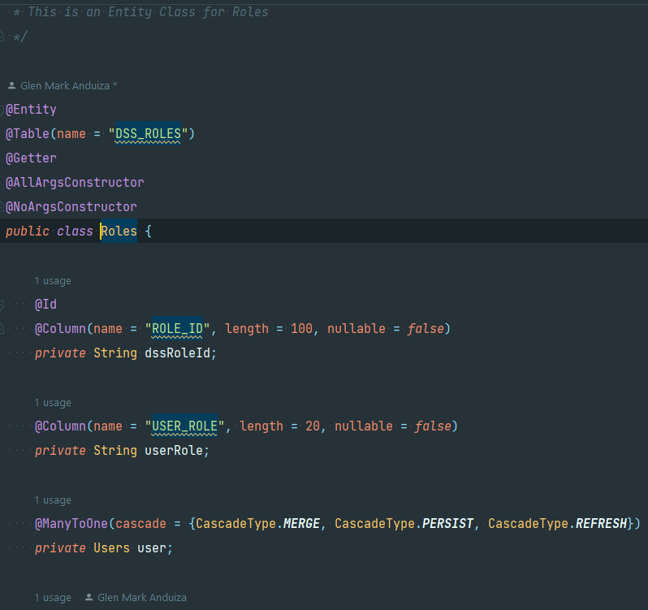
ENTITIES
Users class
Roles class

Slide 43
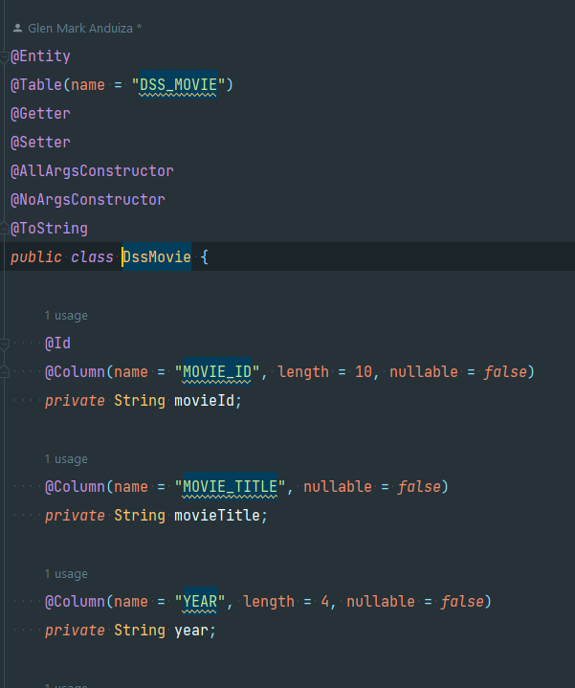
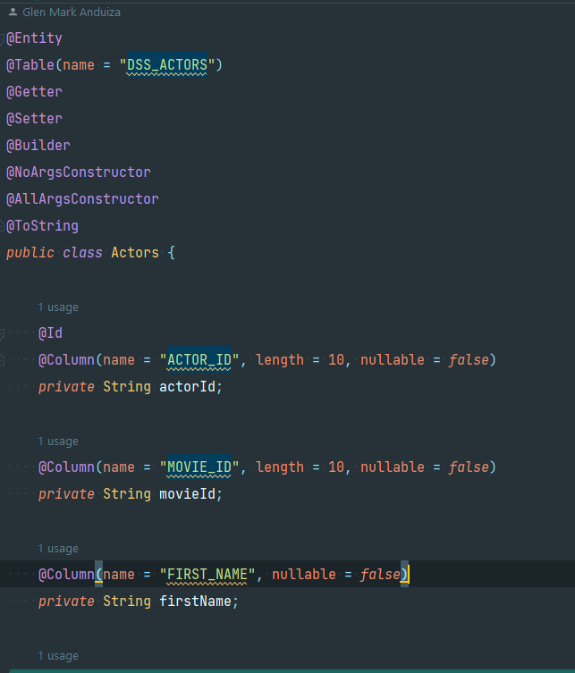
ENTITIES
DssMovie class
Actors class

Slide 44
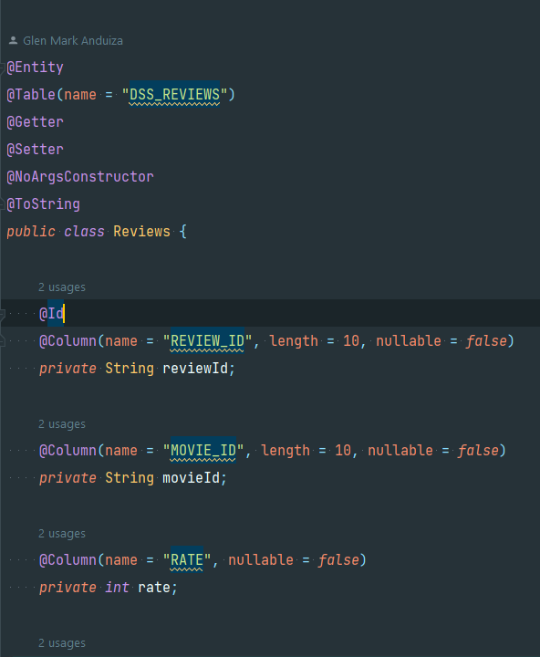
ENTITIES
Reviews class

Slide 45
THANK YOU
Glen Mark Anduiza
Java Developer

